Slide 1
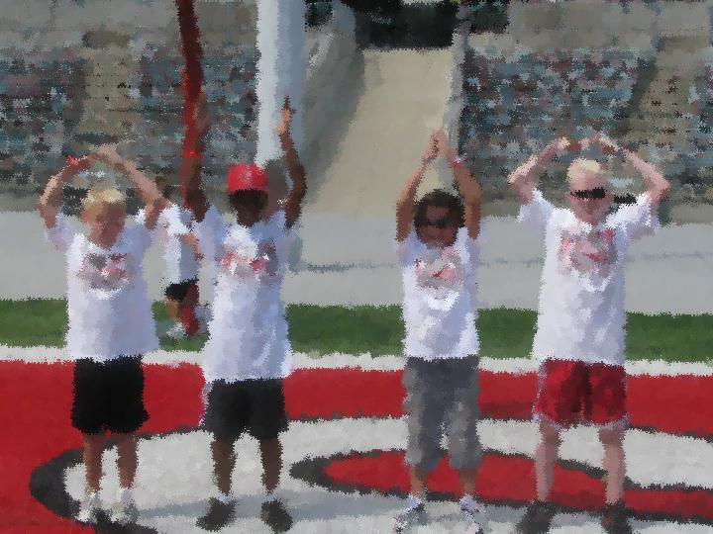
working with Military Kids:
What educators need to Know
Notes:
Welcome by Pete LuPiba, Ohio Department of Education

Slide 2
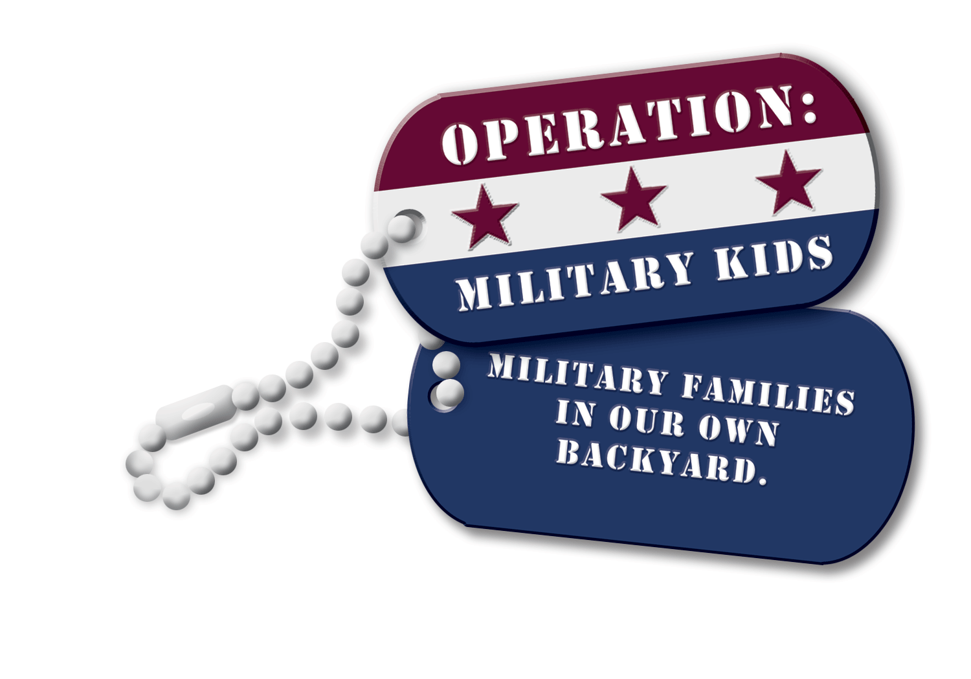
Who we are
Operation: Military Kids (OMK)
Ohio National Guard (ONG)
ONG Youth Program is part of Family Readiness and Warrior Support
Ohio 4-H
OMK is part of Ohio State University’s 4-H Youth Development program
Notes:
Thank you, Pete.
We’re glad to have this opportunity to present this webinar on the topic of working with military youth.
We represent two organizations working together – the Ohio National Guard and Ohio 4-H. We are here because we are deeply committed to our military youth, and we’re fortunate that our organizations have joined forces to support them through Operation: Military Kids, because working together we are much stronger than working alone.
Before we get started, we’d like to tell you a little bit about who we are.

Slide 3
Mission
The mission of the Ohio National Guard’s Education Outreach Program is to identify military connected youth in the schools and provide them, their families, and their educators with the information, resources, training, and opportunities to ensure their success in school and in life.
Notes:
I’m Len Klakulak and I’m here representing the Ohio National Guard and the education outreach program, which falls under Family Readiness and Warrior Support. There are currently four staff members working for the Ohio National Guard’s youth program. One specific mission of the youth program is to identify military-connected youth in the schools and provide them, their families, and their educators with the information, resources, training, and opportunities to ensure their success in school and in life.

Slide 4
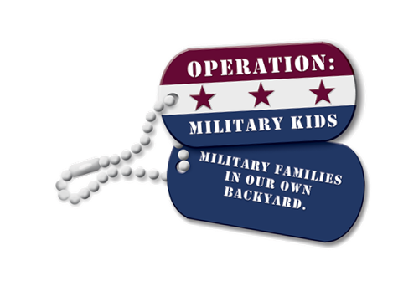
Mission
Through a collaborative effort, Operation: Military Kids seeks to provide support to youth impacted by deployment. Through our joint efforts, we work to develop a sense of support from the community and enhance the well-being of military youth & families.
Notes:
I’m Theresa Ferrari, a youth development specialist with Ohio 4-H Youth Development program, which administers Ohio’s Operation: Military Kids program, or OMK. OMK is part of a national initiative begun in 2005 to provide support to youth impacted by deployment. Our funding allows us to hire a full-time program manager. However, we are all about developing community capacity in order to reach military youth, because there is no way that we could do it alone, and that’s why we’re pleased to join forces with the Ohio National Guard. The common denominator is providing positive youth development experiences.

Slide 5
Outline
Military Kids:
Who Are They?
Where Are They?
What Do They Need?
What Can We Do?
How Do Schools Reach Out to Military Youth?
What Resources are Available?
Notes:
We’re here today to discuss military youth – who are they, where are they, and what do they need. We also want to discuss what schools can do to reach out to them and resources that are available for that purpose.

Slide 6
Notes:
This photo needs no caption. Everyone remembers where they were when they heard about the attack on the Twin Towers in 2001.
The aftermath of that day is why we are here today: to talk about what can be done to support military youth in our communities.
What is the situation? Since 9/11 we have experienced the largest deployments of National Guard members since World War II. Since that time, over 21,000 service members from the Ohio National Guard alone have deployed. 9/11 changed the expectations for service members in the Guard and Reserve and created “suddenly military” youth – youth who up until that point did not consider themselves to be in a military family and where thrown for a loop when they had to deal with a parent’s deployment.
These children, and those of service members from across the five branches of the service, nearly 33,000 in Ohio, are the subject of today’s webinar.

Slide 7
Military kids
Who are they?
Where are they?
What do they need?
Notes:
Let’s turn now to military kids. We will be addressing the questions of who they are, where they are, and what they need in this first part of today’s webinar.
To help us do that….. We’re going to take a look at a video that will give us some perspective on this topic.

Slide 8
What Military kids want you to know
Staying Strong: How Schools Build Resilience in Military Families
Notes:
The title of the video is “Staying Strong: How Schools Build Resilience in Military Families” (from Home Base Program http://vimeo.com/47942649 with a total running time 25:22)
We specifically chose this video because of the similarities between the situations you will see in the military families in Massachusetts – in the video – and those in Ohio.
For example, although Ohio has more military youth than Massachusetts (about two and a half times as many), the majority of the military population in both states are members of the National Guard and Reserve.
And although every family’s situation is different, the video will portray some of the issues faced by these families.
We’ll show it in FOUR segments, and discuss some of the main points after each segment.
[run video until 9:04]
Usually at night I think about him the most. Like, how many more days til he comes home, what’s he doing there right now.
Husband went in May 2004 first deployment, returned home in December 2005. That was a very long time. Eddie was 3 at the time, turned 4 while he was gone. I had the triplets while he was gone. So when he came home it was chaos. Off he went again, with five children at home, because we had had Jonathan. When he left, their life just kind of went “kaboom.”
News clip of soldiers marching; 181st Infantry, heading to Afghanistan.
For the first time in our nation’s history our armed forces are filled with men and women who are parents.. Today’s military: 40% are parents. Unprecedented number, represents hundreds of thousands of parents who are separated from partners and children.
Over 2 million children have had a parent deployed….[how many of them live in Ohio? = probably about 50,000 Ohio youth have had a parent deployed]
Much more complex experience of deployment, because they are service members living in civilian communities.
Don’t have the infrastructure in place like large military states.
Civivlian employment is disrupted.
Until you go through it you don’t understand it. You’re not part of a base community. You’re alone....or you think you’re alone.
You live in your family and assume you’re the only one who does the National Guard. Everybody says thank you, but still feel isolated.
Jennifer Flewelling, Principal at North Beverly elementary school – new family in the Coast Guard; counselor says “we realized we had other military families, and other military connections, nephews, neighbors, older siblings.”
I think we can do a lot of good. But what do you think we can do?
Would I be interested? I think I burst out crying. Emotions were high then.
Service member: Soldier can control environment. But You can’t control what’s going on back home. It’s comforting to me that the school was going to take the initiative during the deployment.
Decided we had to organize ourselves; board meetings – Question 1: what are we? (what about Ft. Beverly, it just stuck)
The more we talked, concluded that we could have an impact in the lives of kids and their families.
[at 5:45] shows kids in hall, classroom, with teacher]
Parents’ military deployment is a stressful experience for the family and for the children.
Elementary schools are one of the most perfect places we could begin to establish sources of support and resilience for military children. Children spend so much of their time at school and teachers are a so important.
I’ve been overwhelmed with the amount of resources. Schools have the access, relationships, with them every day. duty to serve as laisons to connect the resources and access.
Family Programs for National Guard: financial assistance, deployment support. family readiness groups, etc., reach out to find out what kinds of programs are already in place for them to tie into.
For me, the Hardest part (for parent) is dividing time up to make sure they get one on one, they don’t. get time with each.
They know if they wrestle, I’ll come. Lots of testing behavior goes on.
[Students saying Pledge of allegiance]
4th grade teacher; Eddie Avery is in her class. had a heads up about his father’s deployment; knew Eddie was quiet, shy, as the year went on, I knew if I talked to him and didn’t ignore the situation, knew he felt comfortable to talk about his dad.
Mark being away has changed Eddie a lot; didn’t want to go to baseball because his dad wasn’t there; didn’t want to play flag football, what was the point. It just brings up so many emotions.
[Run this clip until 9:04]

Slide 9
Military kids
Who are they?
Where are they?
What do they need?
Notes:
Let’s revisit some of the points brought up in this first video segment.
Who are military kids?
Of course, it’s not the kids that are in the military, it’s their parents. As the sons or daughters of military service members, you could say that they were born into it.
We know that there are nearly 33,000 military kids in Ohio (that’s 32,964 to be exact), based on the latest figures we have from the Department of Defense from September 2012.
Those 33,000 are the military youth who are tracked (that is, they’re military dependents). But if you think about it, military youth can also be the brother or sister of a military service member. Some of our young service members will still have younger siblings at home who are affected when their big brother or big sister is deployed. We just don’t know how many more young people fall into this category of “military kids.”
We often don’t have to look far to find military kids. As the saying goes on the OMK dog tags, they’re “in our backyard.” How many of you have someone in your household connected with the military? Someone in your extended family? A neighbor? Do you know how many military youth are in your classroom or school?
In the video, a new family enrolling their children in school identified that they were a military family. What did the school personnel realize when this new family came to their school? They wondered if they might have other military kids that they weren’t aware of. That’s all it takes to get started.

Slide 10
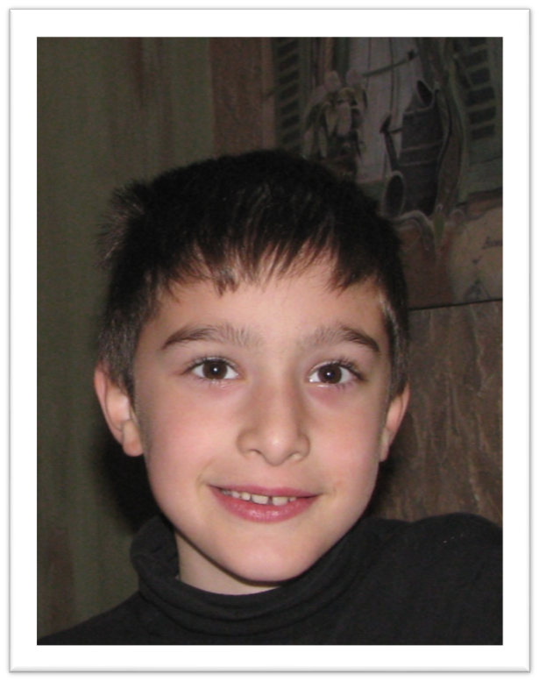
Which one is the military child?
Notes:
So how do you identify military kids? Let’s try: Which one of these two is the military kid? They look a bit alike, don’t they.
Well, that was a trick question. You can’t tell just by looking, can you? [Believe it or not, when I have shown this slide before I actually have people tell me which one they think is the military kid!] But there’s nothing on the outside that would distinguish them as such. They don’t go around with a big red “M” on their forehead to announce to all that they are a military kid. They are, first and foremost, like any other kid.
In case you’re wondering, the one on the right is the military kid. The one of the left is my nephew, and he’s not a military kid!
[Our military kid is Tyler and this photo was taken when he was a 12-year-old camper at one of our Operation: Military Kids camps on Kelleys Island. Tyler came for several years as a camper and for two years he has been a counselor at this camp.]

Slide 11
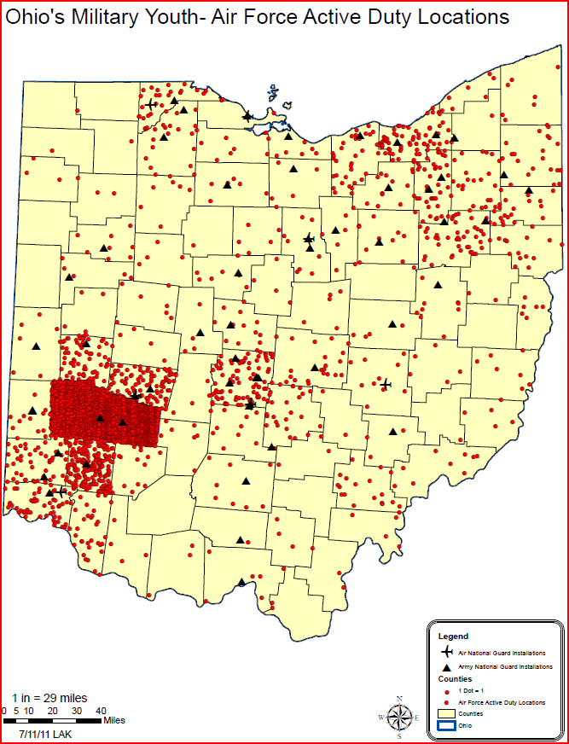
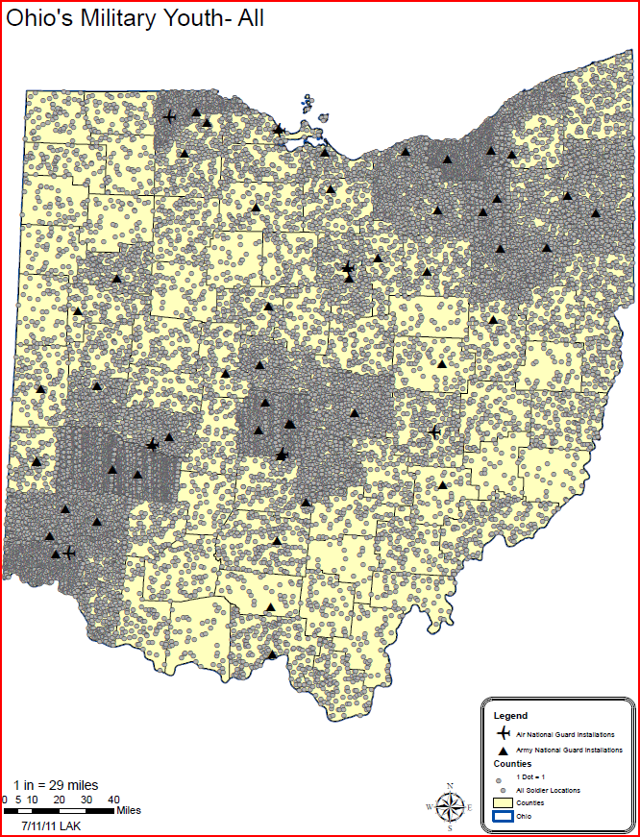
Where are Military youth in ohio?
In our backyard - Military youth are located in every county of Ohio.
Where there are kids, there will be military kids - Areas of concentration follow the population distribution.
Notes:
We may not be able to tell just by looking, but we do have an idea of where military youth are in Ohio.
● First, because a common misconception is that Ohio’s military population is tied to Wright-Patterson Air Force base, the first map shows only those youth who are part of Air Force active duty families. Each red dot represents one youth. You can see that all of Greene and Montgomery counties are red – that’s where Wright-Patt is and they have lots of military youth. Communities surrounding military installations will have larger populations of military families. But also you can see that there are active duty Air Force youth scattered in other parts of the state.
● But now let’s look at all military youth in Ohio. [Click to advance to next map.] This map with the gray dots paints a different picture, doesn’t it. You can see from this map that military families live in every county in Ohio.
● All those dots add up to approximately 33,000 youth in military families in Ohio. (32,964 as of September 2012)
● However, military youth follow the pattern of the general population— here there are people, there are military youth! That’s why you see lots of dots in our urban areas, and fewer dots in the southeastern part of the state.
● The other thing to pay attention to on this map is the icons – small planes represent Air National Guard installations and triangles represent Army National Guard installations. There are also reserve centers for the Army, Air Force, Navy, Marines, and Coast Guard around the state. Unlike Wright-Patterson Air Force Base, these locations are not residential facilities. People work there, but don’t live there. You may drive by them and not really notice them, or not really know what goes on behind the gates.

Slide 12
What do Military Youth need?
Military Kids Are Kids First!
They have the same needs as all young people.
Notes:
Let’s talk a bit about what military youth need. The most important thing to remember is that military kids are kids first. First and foremost, they have the same needs as all young people do. They need opportunities to grow and develop to reach their potential.

Slide 13
What do Military Youth need?
Military kids have unique needs. that are related to the nature and challenges of the military lifestyle.
Notes:
However, military youth also have unique needs that are created by the military lifestyle. For active duty families, this has always meant periodically moving from one military installation to another. But for all military youth, being in a military family is characterized by separations, as you saw in the video.
In particular, we are concerned with those who are part of the National Guard and Reserves of each branch. They are geographically dispersed throughout the state and are not near a military installation, so they are not close to the services that are available and they are not close to other military families.

Slide 14
Understanding deployment
Deployment:
When a service member is assigned a military duty away from home and cannot be accompanied by family members.
Notes:
Deployment is a situation shared by many military youth, whether they are active duty, National Guard, or Reserve. Over the past 10 years, many youth in Ohio have dealt with not just with one, but with multiple deployments.
We’re going to look at another video segment. In this part of the video, we’ll hear from parents, service members, and youth themselves what it means to have a parent deployed. We’ll also see how this school in Massachusetts – with 12 military youth – is working to support their military students.
[Start video again at 9:04]
Skype at dining room table.
Gracie misses her dad so much; if she has free time she is drawing flag that says welcome home dad; everything she does is to send to her father.
If parent at home is coping well and maintaining their own sense of equilibrium, then children can continue to move forward and meet developmental milestones.
I think the parent does set the tone for the house, service member too, when the talk or Skype with him, it’s all very positive, great job in your baseball game. They still stay connected.
Eddie: When I Skype, it kind of makes me sad that he’s halfway around the world and I’m here and he doesn’t get to be here with us.
Have to grow up with a sense that their parent is there but not there; chronic state of being absent but present is a unique kind of stress for military families.
Sophia: I normally have two parents watching me and I don’t really feel happy with one parent watching me.
School nurse: Any number of issues; most likely have some kind of somatic complaints, headache, stomachache, tired
Parent: Need a little extra pat on the back or hug, sometimes have little ailments, need a band aid even if cut wasn’t there
Nurse: Really crucial to be able to maintain communication between team here at school. Guidance counselor, teacher, principal, all have some input into the quality of the child’s day
Parent: Not about being strong, about being connected, sharing ideas, sharing thoughts, that’s what I think is important here.
Parent: Parent has to email and say ‘We had a bad morning, etc., so they know where this is coming from
Eddie talking to teacher. Eddie’s taken this ‘I can do it by myself and not bother my mom. We make it point to check in with him, be more understanding is the biggest things as an educator.
One of the invisible things to cope with is constant fear about partner’s safety – injured or killed at any moment, significant emotional issue to come to terms with.
Parent: My answer to how I deal with it is I don’t deal with it. In the middle of it you keep going. Kids show it more. Children have a lot of nightmares.
Teacher: Michelle is very honest about her concerns and worries she has for her children, through that honesty has given me the opportunity to work with her
Most military spouses are unsung heroes. Men and women go off to war. But they leave families at home. Create the stability and continuity for every family needs for health and cohesion and harmony.
The Goal: To Build Resilience [15:00]
Resilience in a child implies that a child is doing OK in spire of adverse circumstances
Think about it like the Pillsbury doughboy – even when pressed initiatlly, they bounce back
Military support group …..Bubbles are like feelings, come in all different shapes and sizes, last for a long time or a little bit of time.
Promote resilience with Biweekly support group for military connected students
Sophia: You can be a little bit sad, a little bit happy.
Teacher: Want them to understand that there are other students in the school who are experiencing the same kinds of issues that they are going through every day
Sophia: Felt sad, through he was going to change a little.
Resilience comes from being connected to other people who know about you, care about you, encourage you to use your inner resources to meet a challenge.
Skype with CPT Avery and the entire classroom
Being able to see someone they know, someone who is connected to a classmate of their. connects the child to the larger community
Military is not a sea of faceless individuals, they are fathers and mothers just like them.
“What time is it in Afghanistan?”
Globe
Brings an awareness Inherently it develops empathy, creates more of a bond, students come together to support these families
Eddie: Dad, when you come, can you come to classroom again?
Michelle: Doesn’t like that it makes him different, but he has pride in what he is do ing.
For a child like Eddie to present this important figure in his life, who is serving an important mission, allows Eddie to feel that his life is more fully understood in the context in the school.
Teacher: He had “golden moments” that day. I was very proud of him.

Slide 15
Understanding deployment
Pre-Deployment:
Service member receives notification of mobilization. Unit, service member, and family prepare for departure.
Notes:
Let’s take a minute to review briefly what you have just seen in the video.
Deployment has now become commonplace; to have a parent deployed within the past 10 years is a situation shared by many military youth. Many youth have dealt with multiple deployments. Generally speaking, a deployment can be divided into three phases.
Pre-deployment begins when the service members receives notification of his or her unit’s mobilization. Preparations for departure take place on multiple levels. There may be additional training needed prior to deployment. The family’s affairs need to be put in order (including financial and legal matters) and support systems accessed. In this phase culminates with the departure of the service members.
What I’ve just described depends on the branch of service. Some service members go as individuals or pairs attached to another unit so their departure goes relatively unnoticed, except by those closest to them. In the case of an entire unit deploying, there may be a Call to Duty ceremony. Regardless, deployment takes service members away from their families for a period of time to perform their military duty.

Slide 16
Understanding deployment
Deployment:
The time when the service member is away from home.
Notes:
Deployment is the next phase. The length and frequency of deployment depends on a number of factors, including the branch of service. A “typical” deployment for the Army National Guard is one year; Air National Guard missions are typically shorter but more frequent.
Units vary in size from brigades (which is about 2,000 – 2,500 soldiers) to small teams of a dozen, or even individuals or pairs. During this time, the location of the deployment will dictate how frequently and through what means the service members are able to communicate with their family. Operational security will dictate the level of detail that they can talk about.

Slide 17
Understanding deployment
Post-Deployment:
Begins with the service member’s arrival back home & continues as life returns to a “new normal.”
Notes:
Let’s look at another section of the video that will focus on the third phase of deployment.
Start video at 18:41 and continue until
[18:41] Welcome home
New clip
When the parent returns home from war, it’s almost as thought the real challenge begins. We think, oh, it’s great; the family is reunited, the family is good to go. In fact, many things need to be renegotiated once a parent is back from deployment.
Lisa: I was the only parent for 11 months, the only one disciplining. When he came back, He slowly got back in the swing of doing that.,
Michelle: Getting back to co-parenting, it’s important. It’s hard re-introducing them to their father, so they can see him as another authority in their lives.
Guidance counselor: The reintegration process can bring up a variety of different emotions. How is the family going to change? How is this change going to affect me.? Where am I going to fit in the new family dynamic when dad comes home.
Opportunity for the parent to return to the school community closes an important loop for the family and the school. Marking the end of a shared challenge.
Made me feel great that she had a look of pride on her face. See me in person as opposed to being on a screen. Made me feel great.
Walked into that classroom in his uniform.
So many different emotions. It was awesome, it was a great feeling.
Did you see scorpions?
I want to show everyone what you can do now that you’re back from Iraq.
The principal mechanism by which communities of resilience are built.
Presenting a flag to the principal.
Thank you!
[Show video until 22:37]
Let’s review what we’ve just seen on the video. The section of the video that we just saw focused on the welcome home aspect.
Post-deployment begins with the service member’s arrival back home. The first part is usually a “honeymoon” period of sorts. Everyone is glad to be reunited. This post-deployment period continues as life returns to a what is referred to as a “new normal.” This other term for this phase of deployment is reintegration.
Keep in mind that this is a cycle, and that after a period of time, it begins again. Part of the “new normal” is that it’s not “if” but “when” the service member’s unit will deploy – this is one of the things that changed since 9/11. And for the National Guard, there will always be the state missions, such as floods, hurricanes, and other natural disasters, that they are called upon to serve in; often these are no-notice missions.

Slide 18
Coping with Change
Deployment is about coping with change.
“I was pretty devastated. I didn’t know what to do or where to go.”
Military teen
Notes:
Deployment is about coping with change. You can see the quote on this slide from a military teen when he found out his dad was going to be deployed: “I was pretty devastated. I didn’t know what to do or where to go.”
And as we have mentioned, many have experienced multiple deployments. Each deployment is different, however, because the child is older and in a different phase of development. Although it might seem logical that a second deployment is easier, that’s not what people tell us.
Deployment is a change that brings about stress. Each child has a “typical” reaction to stress. Those who know the child well, like parents and teachers, will recognize these signs, and know that something is going on with that individual, as was pointed out so well in the video.
And as was also pointed out in the video, and has been backed up by research, how well the at-home parent copes has a lot to do with how the children handle these deployment-related stresses and changes.

Slide 19
Change creates Stress
“This camp gave them a few days to forget all of the worries of being a kid whose daddy is deployed.”
Parent of two military kid campers
Notes:
What kinds of stresses and changes are we talking about? Again, it will depend on a child’s age, but research and experience tell us that these are some common experiences with deployment:
• Changes in daily routines
• Increasing responsibility (such as in caring for younger siblings and household chores)
• Concern about the deployed parent’s safety and well-being
• Concern about the at-home parent’s well-being
• Feeling that others don’t understand what they are going through
• Parent misses everyday activities and special events
• Feelings of sadness, frustration, anger; mixed feelings
• Hiding feelings or lashing out
• Need better ways to cope with stress
• Change in school performance brought on by changes and stress associated with deployment
And as was also pointed out in the video, and has been backed up by research, how well the at-home parent copes has a lot to do with how the children handle these deployment-related stresses and changes.
Coping with change CAN have a positive effect: It can be growth inducing and foster maturity. As well, it can encourage independence, flexibility, and adaptability – all skills for adjusting to separation and losses faced later in life. It can strengthen family bonds and create new friendships, and finally, it can foster relationships with the community.

Slide 20
Change can be Positive!
“Our boys have learned & experienced so much at camp & we love what they come home to share with us. After 3 year-long deployments within 7 years, we know we've got GRIT!”
Army National Guard spouse and parent of 2 military teens
Notes:
Coping with change CAN have a positive effect:
Change can be growth inducing and foster maturity.
As well, it can encourage independence, flexibility, and adaptability – all skills for adjusting to separation and losses faced later in life.
It can strengthen family bonds and create new friendships, and finally, it can foster relationships with the community.
The quote that we’ve included on the slide demonstrates the resilience (or what we like to call GRIT) shown by military families.

Slide 21
So What?
What Can We Do?
Notes:
A logical question is – so what? What can be done to support military youth? What can schools do?
Some ideas have already been addressed in the video. Let’s look at the final segment for additional ideas to wrap it up.
Start video at 22:37 until ending at 24:12
[Next Steps for Schools]
The first thing that school need to do is to identify who military connected children are. We don’t do that routinely, but it would be such an easy thing to do.
Principal: Through a parent survey, registration process, happen to know who they are.
Guidance counselor: In our case we started with one student, realized we had 12, in a school of 400 kids, that’s a good percentage.
Sent out a letter, began a bi-weekly support group for kids, by the way don’t have to be active military to participate, this is a way you can support
Even a personal note home, telling I want to do what I can to support you
Most important things we can do, to help them understand that they are serving too.
Deserve our respect, for their courage and sacrifice. Need to recognize that thank them for that.

Slide 22
What can we do to Help YOUTH TO navigate these changes?
1. Get youth involved in social support networks.
2. Encourage youth to learn new life skills.
3. Teach youth to express stress and emotions in a healthy manner.
4. Promote the importance of doing fun activities.
Notes:
What can we do to help military youth navigate these changes? When it comes to what youth need, here is what one report suggested:
Get youth involved in social support networks.
Encourage youth to learn new life skills.
Teach youth to express stress and emotions in a healthy manner.
Promote the importance of doing fun activities.
In our experience, these suggestions make sense. Through Operation: Military Kids, we have developed programs that do just these things. In particular, we’re known for our camping opportunities. Through camps were are able to embed intentional learning disguised as fun. You’ve seen photos from these camps on many of the slides in this presentation. Our goal is to develop resilient youth who can weather life’s challenges, now and in the future. That’s the GRIT that you’ve seen on some of our t-shirts and mentioned by parents. And we’d even go so far to say that we want deployment is not just something to be managed, but to be a situation that is growth producing.
Let’s continue the discussion of what schools can do. Several ways were mentioned on the video: support groups, newsletters, communicating with parents during deployments, incorporating service members into the curriculum. Others include:
Be educated and informed of all that is out there for military-connected children and their families.
Look for opportunities to educate others on the proud and unique military culture.
Be an advocate for all military-connected youth.
In this next section of our webinar, we’ll address some resources that are out there to assist you in supporting military youth.
[From: Huebner, A. J., & Mancini, J. A. (2005). Adjustments among adolescents in military families what a parent is deployed. Final Report to the Military Family Research Institute and Department of Defense Quality of Life Office. Retrieved from the American Academy of Pediatrics website: http://www.aap.org/sections/uniformedservices/deployment/DeploymentWebSiteResources/AdjustmentsAdol.pdf]

Slide 23
How do we identify Military Youth?
Notes:
How do we identify military youth? They don’t have identifying marks like this young camper has! (as you can see, face painting is quite a popular activity at our events.)
Right now, due to FERPA and HIPPA, we are limited in ways to identify military kids.
As you’ve seen in the video, a family may indicate on their own that they are affiliated with the military. However, more often than not, they will not self-identify. There are a variety of reasons why. Many times, families don’t want to be treated differently or stand out from others.
However, there are some creative opportunities to identify military-connected youth in your classroom.

Slide 24
Opportunities to promote and identify
Month of the Military Child (April)
go.osu.edu/OMK-MMC
Month of the Military Family (November)
Memorial Day
Veterans Day
Notes:
April is Month of the Military Child, which was a key motivating factor for putting together this webinar. It’s a time to raise awareness of military youth and what they need. We’re inviting everyone to Purple Up! in the month of April! The Ohio National Guard and Operation: Military Kids have also teamed up with the Ohio PTA to get the word out, and we’re offering several other opportunities to promote Month of the Military Child. By connecting to the website provided (go.osu.edu/OMK-MMC) you will find several resources, including our “pre-packaged” programs and templates to customize and use in your school and community.
Other opportune times to identify and promote military-connected youth include: November, which is Month of the Military Family, Memorial Day, Veteran’s Day, military-specific current events, troop deployments in your area, and any current social studies or history curriculum that may apply.
We are also working with the Ohio Department of Education and the Military Interstate Compact Committee (which we will talk more about later) on finding a way to have military-connected youth identified on school registration cards, without violating FERPA and HIPPA regulations.

Slide 25
Military Child “Tool Kits”
.
Information Packets That Include:
Resources
Educational Material
Contacts
Checklists
Customized for Target Audiences:
Parents – Students --- Schools
Notes:
One key set of resources provided by the Ohio National Guard and Operation: Military Kids education outreach program are information packets that we call “toolkits.” These toolkits are available for parents, students, and schools, and can be customized to include resources, educational materials, contacts, and checklists as they pertain to each individual situation.
These toolkits are also made available at key events such as:
Yellow Ribbon Events that occur before and after deployments
School Informational Programs
School Staff In-Service and Professional Development days
Inter-Service Family Assistance Committee (or ISFACs) meeting and RISFAC, which is their regional counterpart
Military Child Education Coalition “Guard and Reserve Institute” (or GRI) and “Living in the New Normal” (or LINN) trainings
Our goal is to have these toolkits accessible on-line using current Ohio National Guard, Family Readiness & Warrior Support and similar, appropriately approved websites that are already in place.

Slide 26
Speak out for military kids Youth Groups
Military and non-military youth can help to generate community awareness of issues faced by military youth when a parent is in the deployment cycle
Opportunity to gain valuable leadership, research, organization, technology, public speaking, and presentation skills
Notes:
Speak Out for Military Kids is OMK’s youth-driven community outreach program. Educators, you would make ideal volunteers to get a group going in your local area. Military youth benefit from being connected to each other. Through participation in SOMK, military and non-military youth can help generate community awareness of issues faced by military youth when a parent is in the deployment cycle. SOMK can provide youth participants with the opportunity to gain valuable leadership, research, organization, technology, public speaking, and presentation skills. Youth are then empowered to use these skills in supporting military youth in their communities. We can help you get started.

Slide 27
Resources
On-line, live, one-to-one tutoring service for:
homework help
specialized subjects
research
career services
and more
tutor.com
Notes:
Tutor.com is an online, live, one-to-one tutoring service for homework help. Tutor.com is provided by the Department of Defense as part of its deployment program to benefit all active duty, reservists, National Guard, U.S. military retirees, and DoD civilians and their dependents. Each service branch has a special log-on. Most importantly, it is FREE to military-connected students!

Slide 28
Resources
S.O.A.R.
Student Online Achievement Resources
www.soarathome.org
Program for military families and the school districts that serve them
Free ACT and SAT prep programs
Notes:
Student Online Achievement Resources (or SOAR) is a program for military families and the school districts that serve them. It aims to address the unique challenges facing military children in our nation’s public schools, while also benefitting the overall student population.
Students can take an assessment aligned to state standards and SOAR directs them to individualized tutorials to improve skills where needed. Using this Internet-based application, parents can monitor their children’s progress on-line and are provided with resource materials.
SOAR also offers FREE ACT and SAT prep programs as well as other standardized test programs that are available on-line for military students and their classmates.

Slide 29
Resources
FREE on-line test preparation courses
March2Success
www.March2Success.com
Notes:
March 2 Success is an on-line test preparation course that will provide help with taking standardized tests, and improve math and English skills. March 2 Success is free. The program is developed by the Army and will help prepare students for assessment examinations, college entrance examinations, trade school entrance tests, military entrance test, and applying for a job. To see a demo and register for the course go to the website listed (www.March2Success.com).

Slide 30
Resources
Scholarships
Notes:
Depending on the student’s choices of school, course of study, and other individual information, lists of “military friendly” scholarships as well as military-friendly schools, can be developed and provided. One example that we want to mention today, is the Captain Nicholas Rozanski Memorial Scholarship. The deadline for this scholarship application is April 30, 2013. Criteria and eligibility are available upon request.

Slide 31
Resources
GI Bill transferability
Notes:
With the cost of college continuing to rise, it is important for to know that military members who qualify for the GI Bill or Post 9/11 GI Bill have the ability to transfer their tuition eligibility to their children and dependents. For more information, the best thing to do is contact your local Troop & Family Assistance Center (we’ll share more about these locations on another slide).

Slide 32
Resources
One-time $500 education-related activity funding
Our Military Kids
www.ourmilitarykids.org
Notes:
Our Military Kids provides a one-time grant opportunity, per child, for education-related expenses, such as sports, fine arts, camps, and tutoring programs. The activity is eligible for a grant if it falls in one of those four categories. However, they DO NOT award grants for child care, school tuition, or religious trips. For more information, please check out the website listed here.

Slide 33
Resources
Boys and Girls Clubs of America
www.bgca.org/military
Notes:
Boys and Girls Clubs of America have a program called MISSION: YOUTH OUTREACH that is specifically designed from military youth. Boys & Girls Clubs of America know that times of national crisis can dramatically disrupt a military family’s life. The MISSION: Youth Outreach partnership supports military youth, ages 6 to 18 who coping with a deployed parent by creating a positive, supportive network. Through this partnership, children of National Guard, Reserve, and Active Duty families, who do not live near or have access to a military Youth Center, can receive a free membership to their local Boys & Girls Club.
If you are not familiar with today’s Boys & Girls Clubs, you should know that they are not just an after-school drop-in program, but also provide outstanding academic programs for youth of all ages ranging from the arts, to technical, to academic. Please check them out at the website listed here.

Slide 34
Resources
Student 2 Student
Parent 2 Parent
Students at the Center
Military Child Education Coalition
(MCEC)
www.militarychild.org
Notes:
The Military Child Education Coalition or MCEC is a worldwide non-profit organization whose goal is to serve as a model of positive leadership and advocacy for all military children. Their mission is to ensure inclusive, quality educational experiences and opportunities for all military children affected by mobility, family separation, and transition. They provide responsive and relevant support systems and resources such as Students at the Center as well as free professional training and programs such as Student 2 Student and Parent 2 Parent for families in transition. They also facilitate the GRI and LINN training as mentioned earlier in this presentation.

Slide 35
Resources
Military Interstate Compact Agreement
http://www.mic3.net/
Notes:
The goal of the Military Interstate Compact Agreement (MIC3) is to replace the widely varying policies affecting transitioning military students. The compact leverages consistency: It uses a comprehensive approach that provides a consistent policy in every school district and in every state that chooses to join. Ohio is one of those states.
The compact addresses key educational transitional issues encountered by military families including enrollment, placement, attendance, eligibility, and graduation criteria. Children of active duty members of the uniformed services, National Guard and Reserve on active duty orders, and members or veterans who are medically discharged or retired are eligible for assistance under the compact.
For reference only: In the Ohio Revised Code: http://codes.ohio.gov/orc/3301.60
3301.60 Interstate compact on educational opportunity for military children.
The interstate compact on educational opportunity for military children is hereby ratified, enacted into law, and entered into by this state as a party thereto with any other state that heretofore has legally joined or hereafter legally joins the compact, as follows:
Interstate Compact on Educational Opportunity for Military Children
ARTICLE I. PURPOSE
It is the purpose of this compact to remove barriers to educational success imposed on children of military families because of frequent moves and deployment of their parents by:
A. Facilitating the timely enrollment of children of military families and ensuring that they are not placed at a disadvantage due to difficulty in the transfer of education records from the previous school district or variations in entrance or age requirements.
B. Facilitating the student placement process through which children of military families are not disadvantaged by variations in attendance requirements, scheduling, sequencing, grading, course content, or assessment.
C. Facilitating the qualification and eligibility for enrollment, educational programs, and participation in extracurricular academic, athletic, and social activities.
D. Facilitating the on-time graduation of children of military families.
E. Providing for the promulgation and enforcement of administrative rules implementing the provisions of this compact.
F. Providing for the uniform collection and sharing of information between and among member states, schools, and military families under this compact.
G. Promoting coordination between this compact and other compacts affecting military children.
H. Promoting flexibility and cooperation between the educational system, parents, and the student in order to achieve educational success for the student.

Slide 36
Resources
Federal Impact Aid Funding
http://www2.ed.gov/about/offices/list/oese/impactaid
Notes:
Being eligible for Impact Aid Funding may be more realistic than you think. Not only dependents of military families are eligible for counts. Any dependent of a federal employee is also eligible as well as Native Americans and more. To find out if your school may be eligible for Impact Aid Funding, please review the information at the website listed. http://www2.ed.gov/about/offices/list/oese/impactaid

Slide 37
Resources
Troop & Family Assistance Centers
Notes:
The state is served by specialists in six Troop and Family Assistance Centers (TFACs) run by the Ohio National Guard and serving all military branches. You can see the six regions on the map.
TFACs are able to assist with a wide range of family issues, ranging from emergency assistance to finding a babysitter.
Going clockwise around the state, the centers are located in North Canton and Cleveland, Portsmouth and McConnellsville, Middletown, Kettering, Bowling Green and Toledo, and Columbus.
Because of the TFAC infrastructure, wherever there are high concentrations of military youth, there are at least some existing support program options available.

Slide 38
Resources
Regional Inter-Service Family Assistance Committees
http://www.homefront.ohio.gov
Notes:
Troop & Family Assistance Center Specialists coordinate regional versions of the statewide Inter-Service Family Assistance Committee. These regional committees, or RISFACs, meet on a quarterly basis (in January/April/July/October). These regional networks serve to connect those interested in meeting the needs of the military population and help to ensure that all areas of the state are reached. We can provide you with meeting dates and locations for your part of the state.

Slide 39
Resources
Informational Programs
In-Service/ Professional Development
Deployment Cycle Education
Classroom Presentations
Contact us for more information if you are interested in these programs for your school.
Notes:
Education outreach programs include assistance with academic and transitional challenges, assistance with deployment and relocation strategies, and we are currently developing a college credit program for students still in high school.
Contact us for more information if you are interested in these programs for your school.

Slide 40
Website
go.osu.edu/OMK
Facebook
OhioOperationMilitaryKids
YouTube
OhioOMK
Twitter
@OhioOMK
Connect with us!
Find out more!
Notes:
Operation: Military Kids has programs available to assist military youth and their families to help them deal with deployment. These include camps for youth, camps for families, and other activities throughout the year. You’ve seen photos of these programs throughout this presentation.
On this slide we’ve listed our website, addresses for our Facebook and YouTube pages, and our Twitter account. We invite you to connect with us, and direct families to these sites to keep up-to-date with OMK programs and resources throughout the year.

Slide 41
Education outreach
For more information please contact
Len Klakulak
ONG OMK Education Outreach Specialist
Office (419) 868-4543
Cell (989) 289-1893
leonard.r.klakulak.ctr@us.army.mil
Notes:
If you want to get in touch with me (Len Klakulak), I’d be happy to assist you with education outreach questions.

Slide 42
OHIO Operation: Military Kids
For more information please contact
Theresa M. Ferrari, Ph.D.
State 4-H Military Liaison
ferrari.8@osu.edu
614-247-8164
Katie Feldhues
Ohio OMK Program Manager
feldhues.2@osu.edu
614-292-3758
Notes:
And either I or our OMK Program Manager Katie Feldhues would be glad to assist you with more information about military youth.

Slide 43
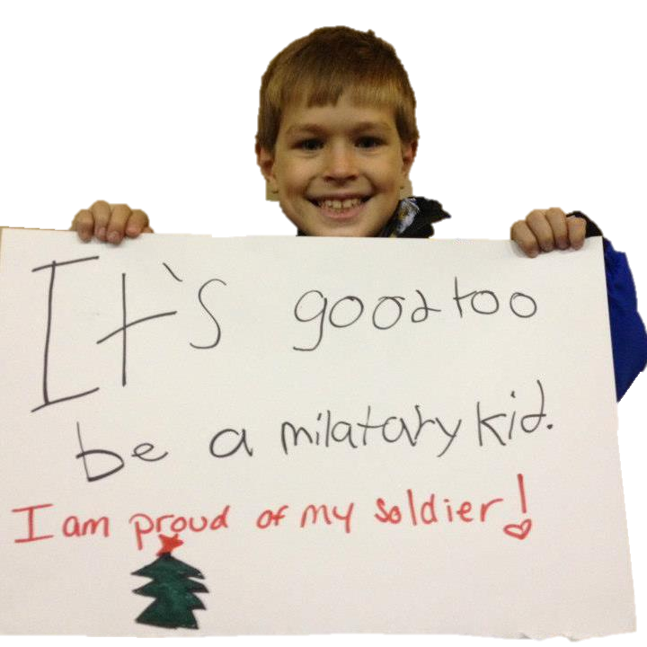
Notes:
In closing, we want to thank you for this opportunity to share information about military kids in Ohio. Keep in mind these three basic points:
Military kids are everywhere in Ohio,
they have unique issues, and
there are resources to help in supporting them.
We hope you will have thought of at least one way that you can take advantage of the information and resources provided here today.
We want every military child to share the sentiment expressed by this young man – it’s good to be a military kid! But we can’t do it without your help! Working together we are much stronger than working alone!

